Slide 1
Final Project Planning

Slide 2
Why are projects so important?
Projects present evidence of the current skills and abilities listed on your resume.
Employers will weight your portfolio heavily when deciding whether to bring you in for an interview.
Interviewers will ask questions about your projects including the challenges you faced and technical questions about your code.
Notes:
Shows skill level
Projects present evidence of the current skills and abilities listed on your resume.
Employers will weight your portfolio heavily when deciding whether to bring you in for an interview.
Interviewers will ask questions about your projects including the challenges you faced and technical questions about your code.

Slide 3
Goals for Project Week
Create a minimum viable product (MVP) to present to your peers and add to your professional portfolio.
Prepare yourself to speak about your project at an interview during a short end of week presentation.

Slide 4
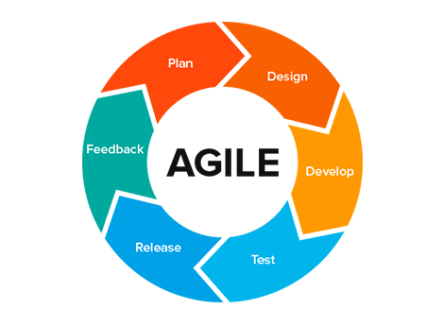
The Agile Development Process
An iterative process in which the lifecycle of software development is broken down into 1-4 week sprints with continuous feedback and improvement.
Image Credit:
MASGLOBAL Consulting
Image link
Notes:
Practice using Agile methodology is highly valued by employers
Emphasizes fast and frequent iteration as well as continuous development of product
Agile development is an approach to software development that puts emphasis on incremental delivery,
team collaboration,
continual planning and learning,
instead of attempting to make a delivery at the end of development.

Slide 5
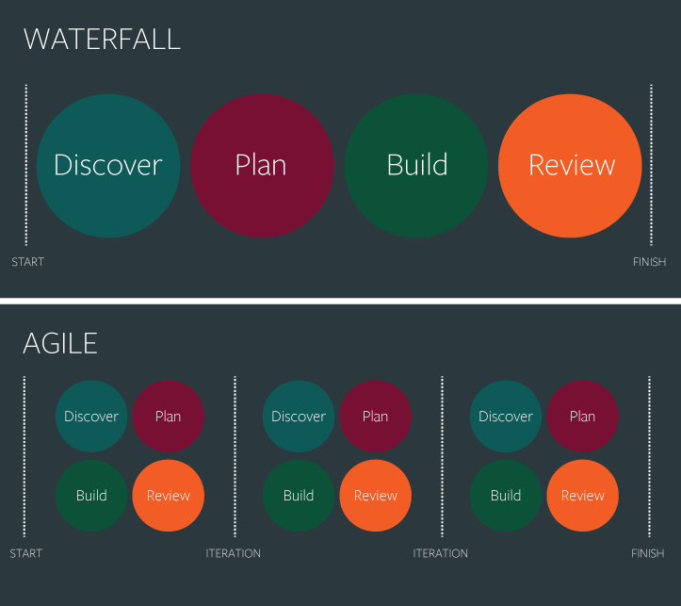
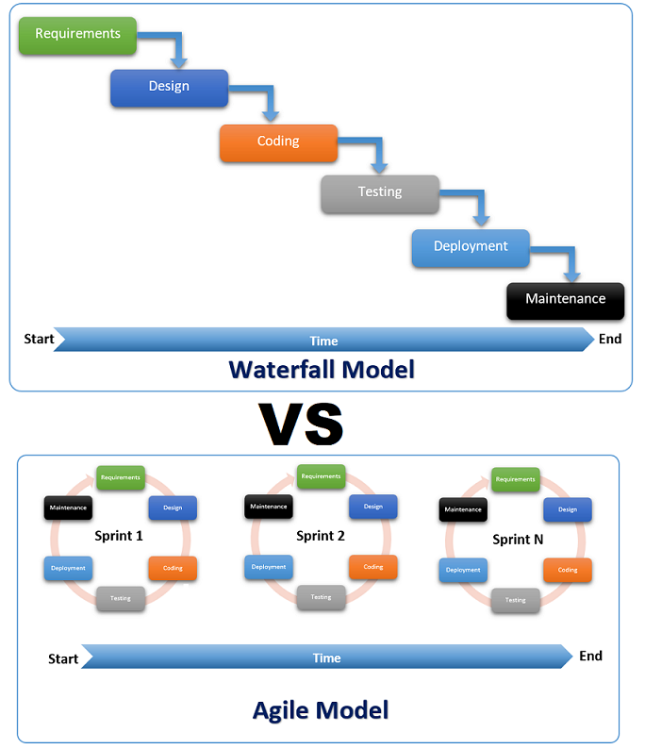
Image credit: GantProBlog, image link
Image Credit: Business Technology - WordPress.com, image link
Notes:
Waterfall is linear and sequential where as agile is incremental and iterative.
Discussion question: Why might an agile approach be advantageous to a company?
Answers: Developers can pivot from original plan more easily, deployment can happen sooner, reduced costs

Slide 6
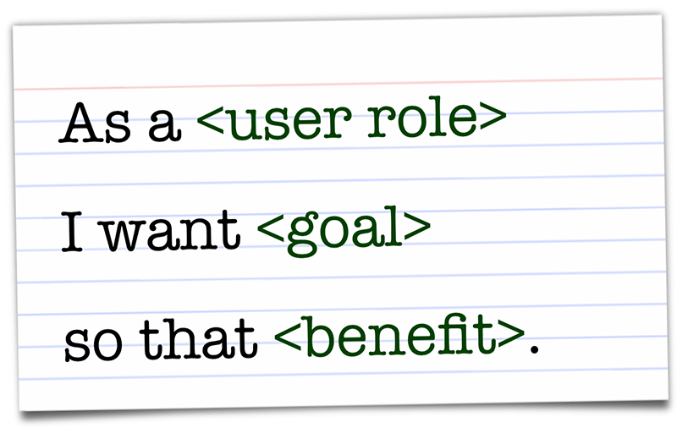
USER STORIES
Agile development is customer centric. They should be made as small and specific as possible. Let’s pretend we’re creating a shopping website.
Of the following two examples, which is a better user story and why?
Example A:
“As a user, I want to visit a high quality website so that I can purchase items”
Example B:
“As a website visitor, I want view inventory with an image, description and price so that I can make an informed decision on my potential purchase”
Image Credit: Scrum With Style, image link
Notes:
User stories are a key component of agile development that you will be practicing during project week.
Agile development aims to accomplish tasks using USER STORIES
DISCUSSION QUESTION: Which is a better user story? Easy check for understanding may be to have students write “A” or “B” in the chat.

Slide 7
Ebay User Story Examples
As a seller, I want to post an item for auction, so I can sell to the bidder who offers the highest price.
As a bidder, I want to make a bid, so I can acquire an item for the lowest price possible.
As a bidder, I want to set a buying limit for an item, so I can automatically make a bid until a certain point.
Discuss: What are some other examples of User Stories that you can think of from websites that you already use?
Notes:
Bullet points defining user role, goal, and benefit.
If possible real websites as examples, user role could be a bidder or a seller on Ebay, goal describes intent what the user wants i want to make a bid, benefit is the big picture, what is the result, so that i can win this auction.

Slide 8
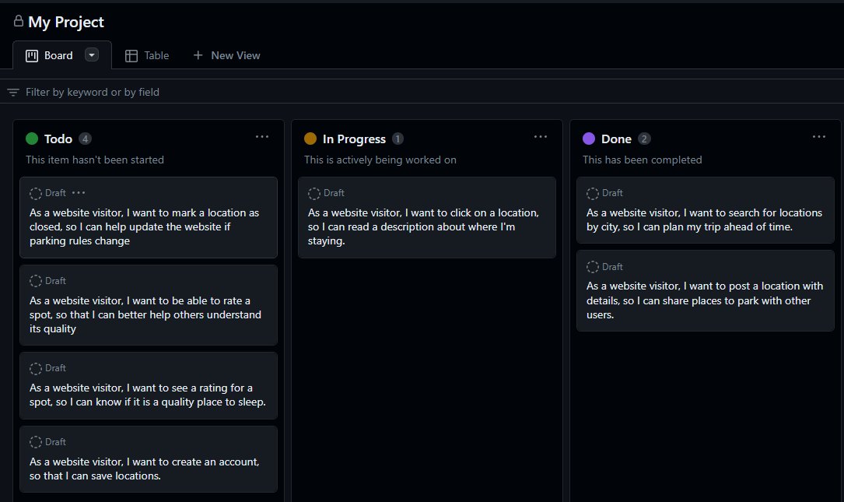
GitHub Projects
Manage your project using a task board in GitHub.
User stories will be placed into a “Todo” category, then moved into “In Progress”, and “Done” respectively.
Prioritize and add a timeline to your user stories to stay on track.
Notes:
This would be a great slide to jump over to GitHub and give a quick demo! Maybe even suggest color coding MVP features.

Slide 9
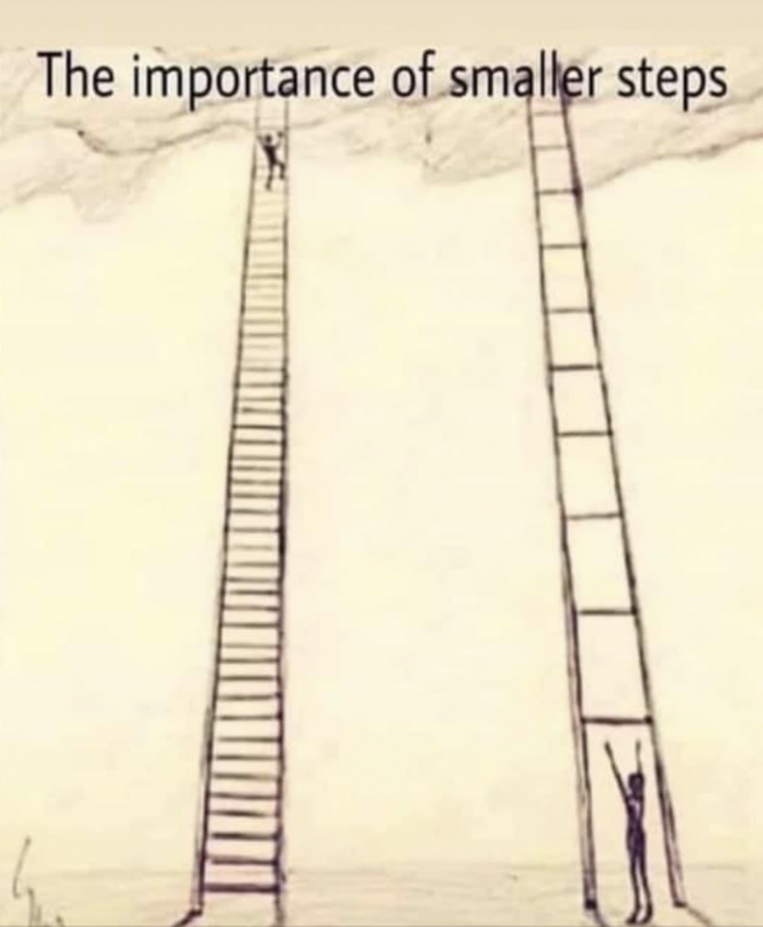
Designing your MVP
Dream big! Then break it down the agile way.
Your minimum viable product (MVP) will be the first step to your original idea.
Image Credit: Aerial Dance, image link

Slide 10
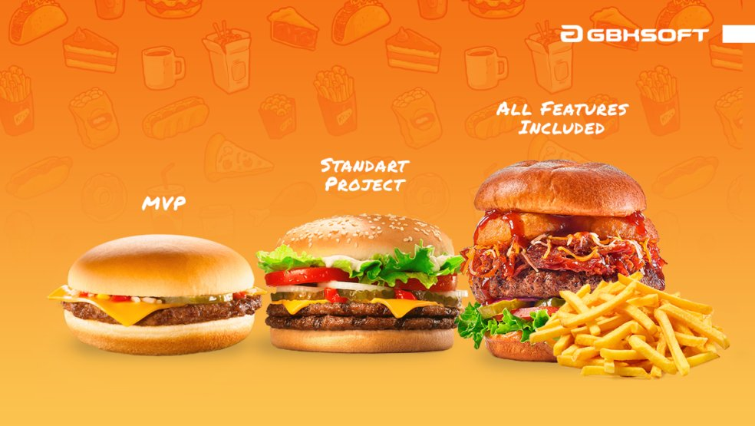
Designing an MVP
Determine the most essential features of your dream website, guided by your project checklist.
This is your MVP!
Seems too simple to show off? Perhaps, but the MVP you create is just your first step!
You can always continue to add features if you have extra time.
Image Credit: Marko Rytkönen
image link

Slide 11
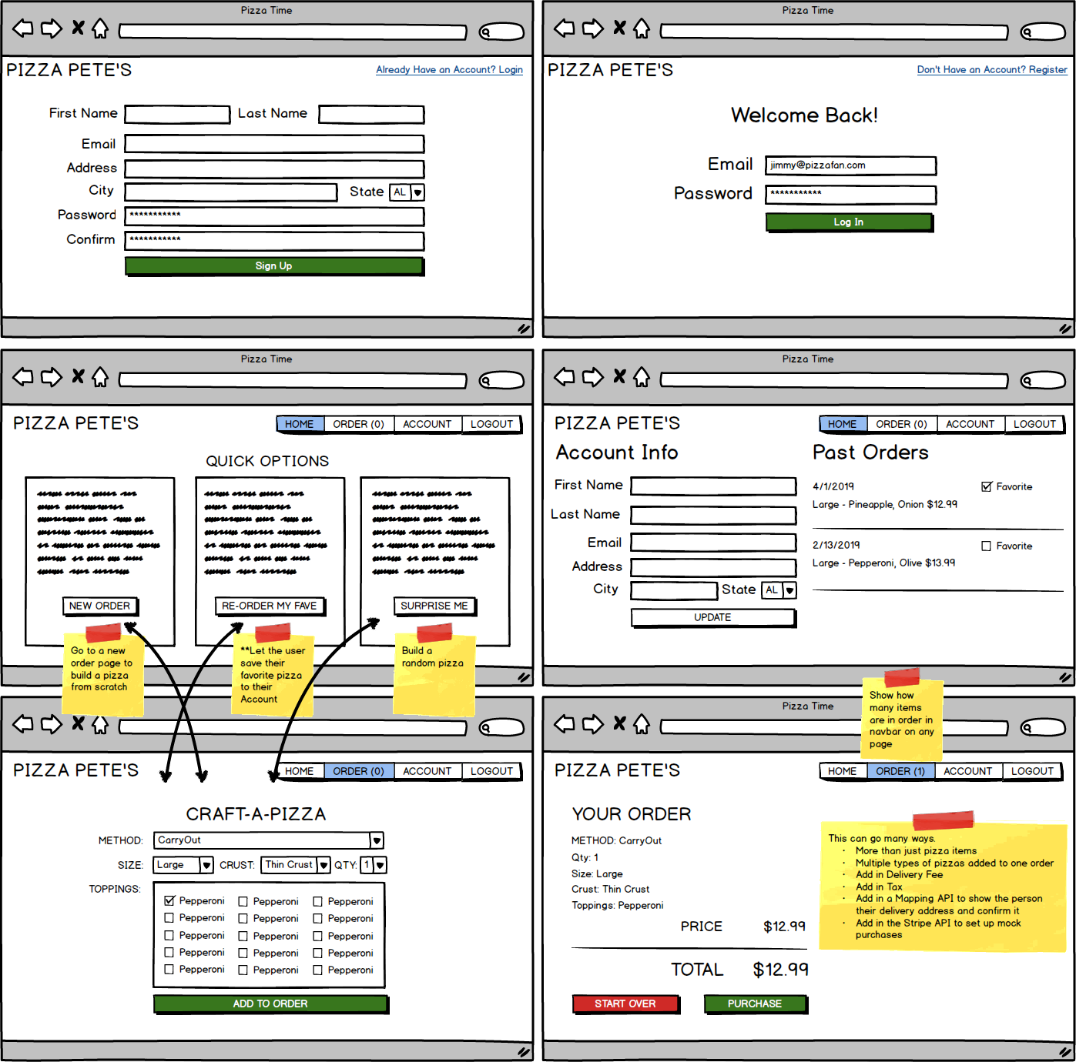
Wireframe Ex. 2:
Pizza Pete’s
Discussion Question:
Which features should be prioritized and built first?

Slide 12
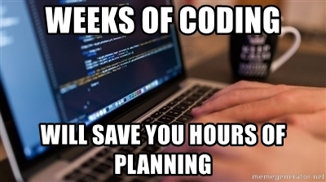
Build your own:
https://balsamiq.cloud/
Image Credit: MemeGenerator, image link

Slide 13
Meeting Schedule
Planning Meeting - Present MVP Wireframe and User Stories
Daily Stand Ups - Report on what you’ve done, what you’re working on
Retrospective - This will be part of your presentation! Reflect on what went well and what could be improved for the next project (sprint).

Slide 14
Presentation
Presentations should each take 10 minutes.
Peers will take notes on presentation and give valuable feedback using google forms.
At the end of the presentation, there will be a short Q&A.

